Slide 1




G
Kathmandu Bernhardt College
English-11
roup
project
By: Group-8
© PrinceTimilsina 2025. All rights reserved.

Slide 2

/page 02
meet the group.
#groupproject
Prince Timilsina
Aabhas Shrestha
Kewal Shrestha
Prabesh Yadav
Ashim Karki

Slide 3





This lesson covers the speech delivered by Malala at the United Nations Youth Assembly on 12 July 2013
/page 01
Unit-1
Education
first
#groupproject

Slide 4

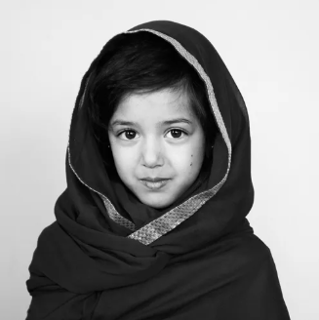
/page 02
Background
She was born in Mingora, Swat Valley, Pakistan on July 12, 1997
In the late 2000s, the Taliban took control of Swat Valley and imposed strict rules that banned girls from attending school
Malala in her childhood.

Slide 5

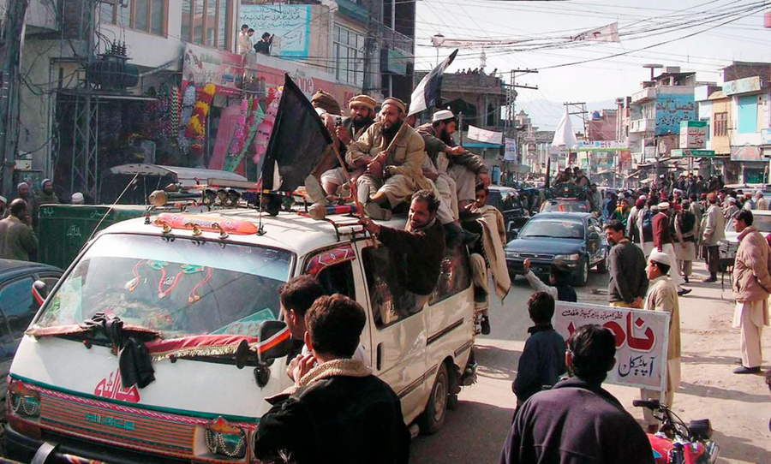

/page 03
Early Activism
Taliban said girls could no longer go to school.
These injustices sparked Malala’s activism: she began speaking out publicly for girls’ right to education despite great personal risk.

Slide 6

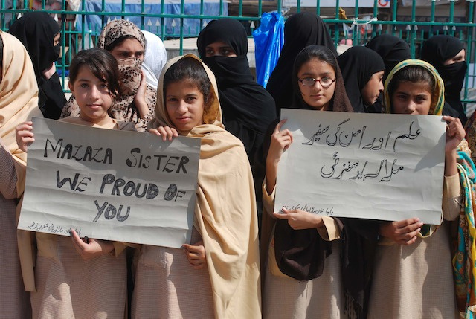

/page 04
Turning Point in Her Life
The Taliban’s opposition to girls’ education grew violent. On October 9, 2012, while riding home on her school bus, Malala was shot in the head by a masked Taliban gunman.
After months of surgeries , she recovered and moved with her family to the UK.

Slide 7
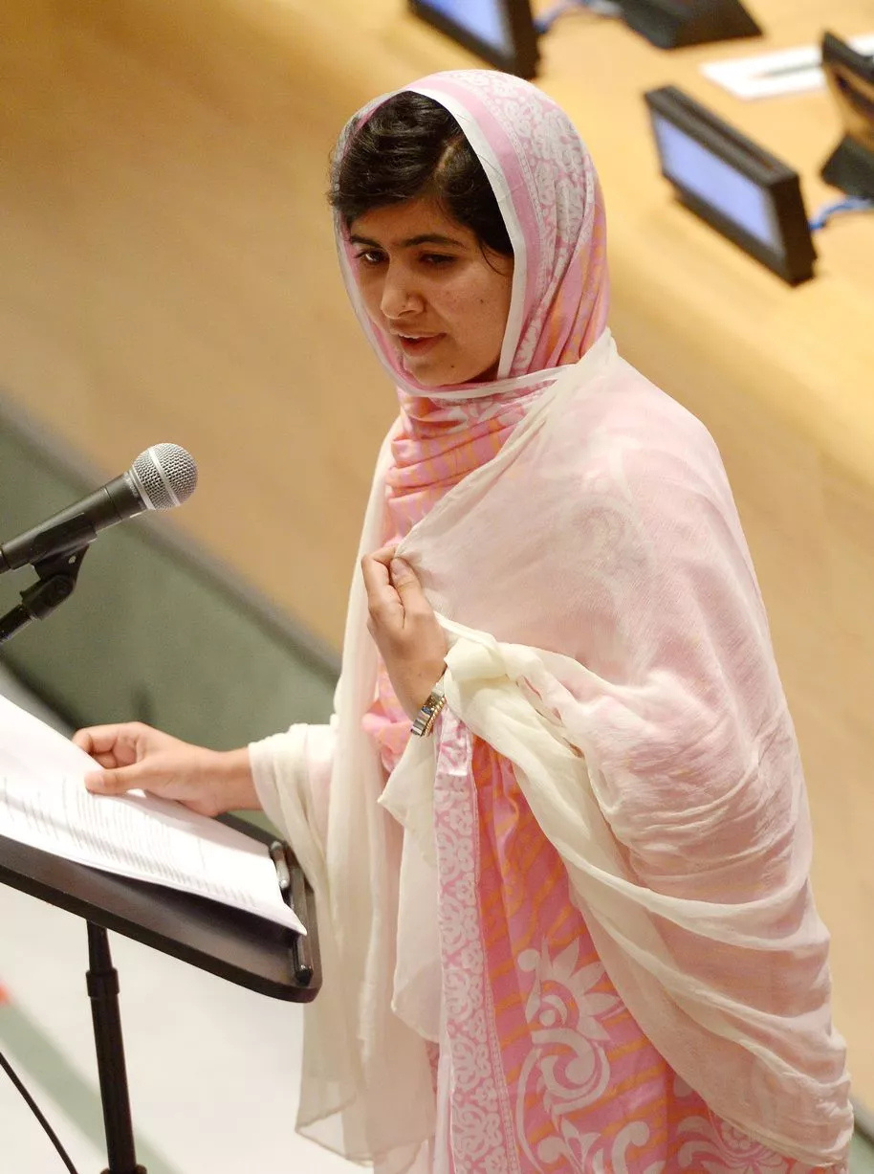

Malala in UN Youth Assembly
Malala at the UN
  She felt honored to speak at the UN after recovering from the attack.
  Thanked God, her supporters, and those who prayed for her recovery.
  She says Malala Day is not her day, but a day for every girl and boy fighting for their rights.
/page 05

Slide 8
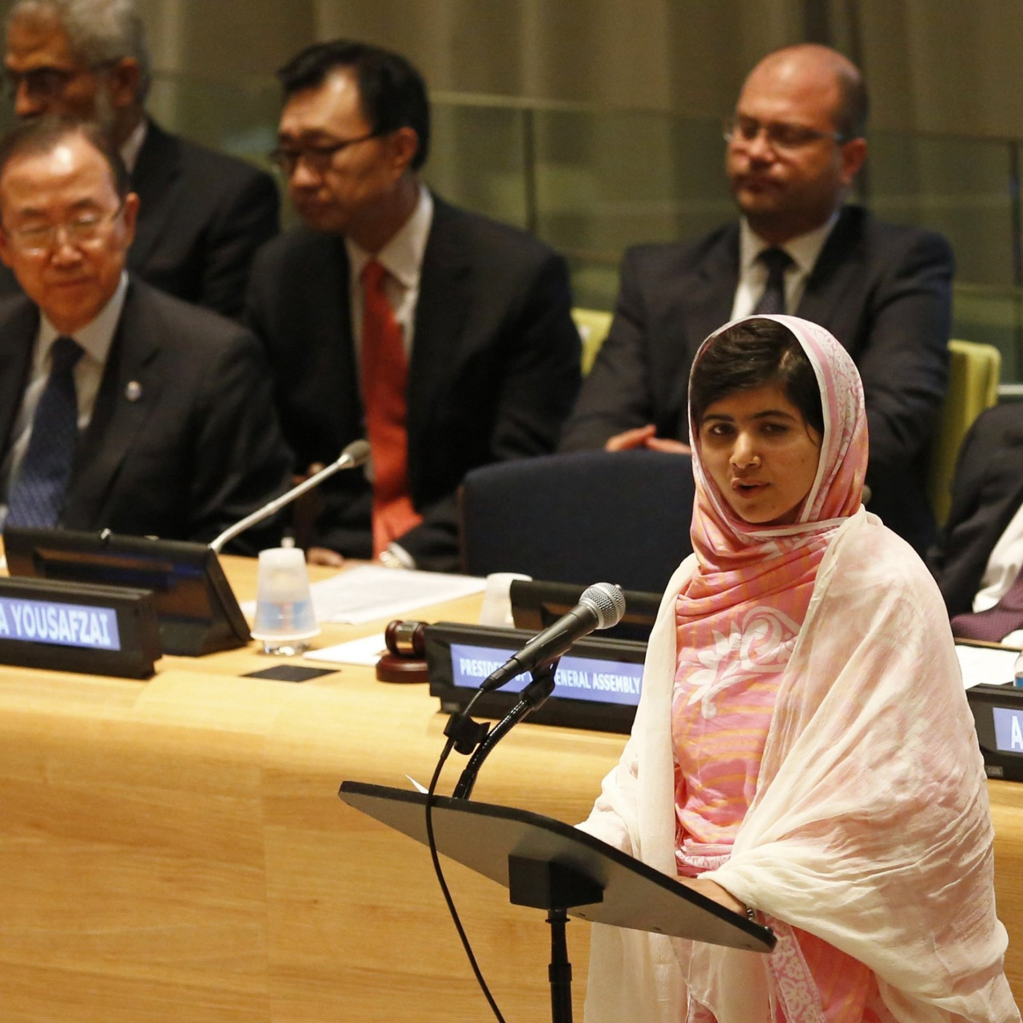
/page 05
/page 06
The Attack and Her Courage
  On 9th October 2012, the Taliban shot her for speaking about education.
  They wanted to silence her, but they failed her voice became stronger.
  She said, “Weakness, fear, and hopelessness died. Strength, power, and courage were born.”
  She declares that her ambitions, hopes, and dreams remain the same.

Slide 9
Message of Forgiveness and Peace
  Malala says she is not against anyone, not even the Taliban. She believes in peace, forgiveness, and compassion.
  Learned non violence from Prophet Muhammad, Jesus, Buddha, Gandhi, and Mother Teresa.
  She said: “Be peaceful and love everyone.”
/page 07

Slide 10
Her Voice for Every Child
  Malala says she speaks not for herself, but for all girls and boys.
  She raises her voice for those without a voice.
  She stands for human rights the right to live in peace, dignity, equality, and education.
  Reminds everyone that millions suffer under terrorism, but still fight for justice.
/page 08

Slide 11
Power of Education and Women
  She says we understand the value of light after darkness and of education after ignorance.
  “The pen is mightier than the sword” extremists fear books and pens.
  They fear educated women and voices of change.
  She mentions that many teachers, students, and workers were killed because extremists feared equality.
/page 09

Slide 12
/page 10
She tells a story of a boy who said: “A Talib doesn’t know what is written inside this book.” She says Islam supports education, peace, and equality, not terrorism.

Slide 13
Her Final Message
key point
key point
  She emphasizes that peace is necessary for education. Wars and conflicts stop children from learning.
  Women and children suffer the most, as poverty, injustice, and ignorance are global problems.
  Calls for women’s rights and girls’ education.
/page 11

Slide 14
/page 12
Her speech ends with a powerful call to action, she urges women to be brave, communities to reject prejudice, and everyone to fight illiteracy, poverty, and terrorism. Her message is clear ; through unity, education, and equality, we can build a peaceful future.

Slide 15
Kathmandu Bernhardt College
Thank you.
© PrinceTimilsina 2025. All rights reserved.

